Slide 1
Ui/Ux Workshop Presentation
Iven Souffrant

Slide 2

Introduction
Iven Souffrant
Junior CSC Major
Correlation of Ui/Ux to Front-End Development
Brainstorming

Slide 3

Project Introduction
Problem: Create a social media app that the current ones lack
Ex Instagram and Twitter
Linking personal social media accts (youtube, twitch and etc)
Include features the other apps lacked all in one app
Target: Teenagers – Young Adults
Reason: Use multiple social media apps for certain things

Slide 4
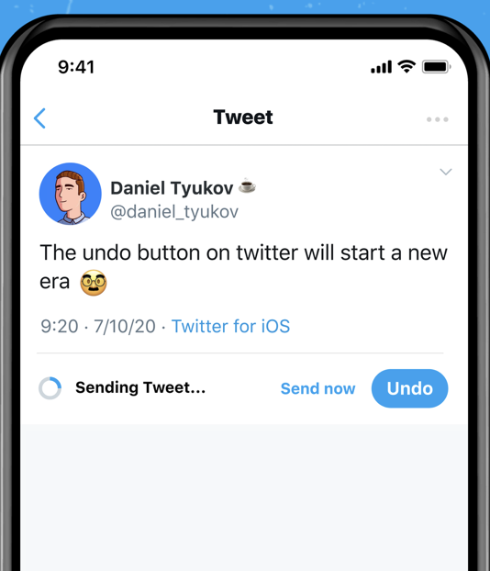
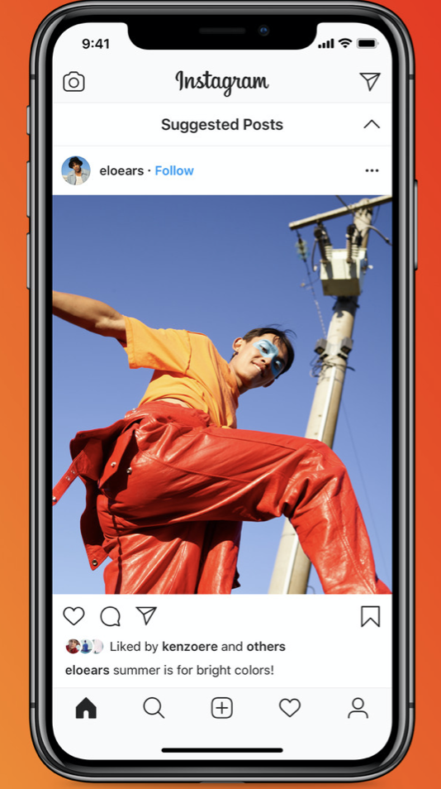
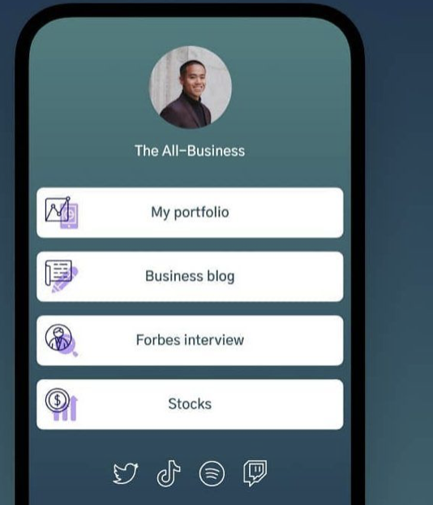
Design Thinking

Slide 5
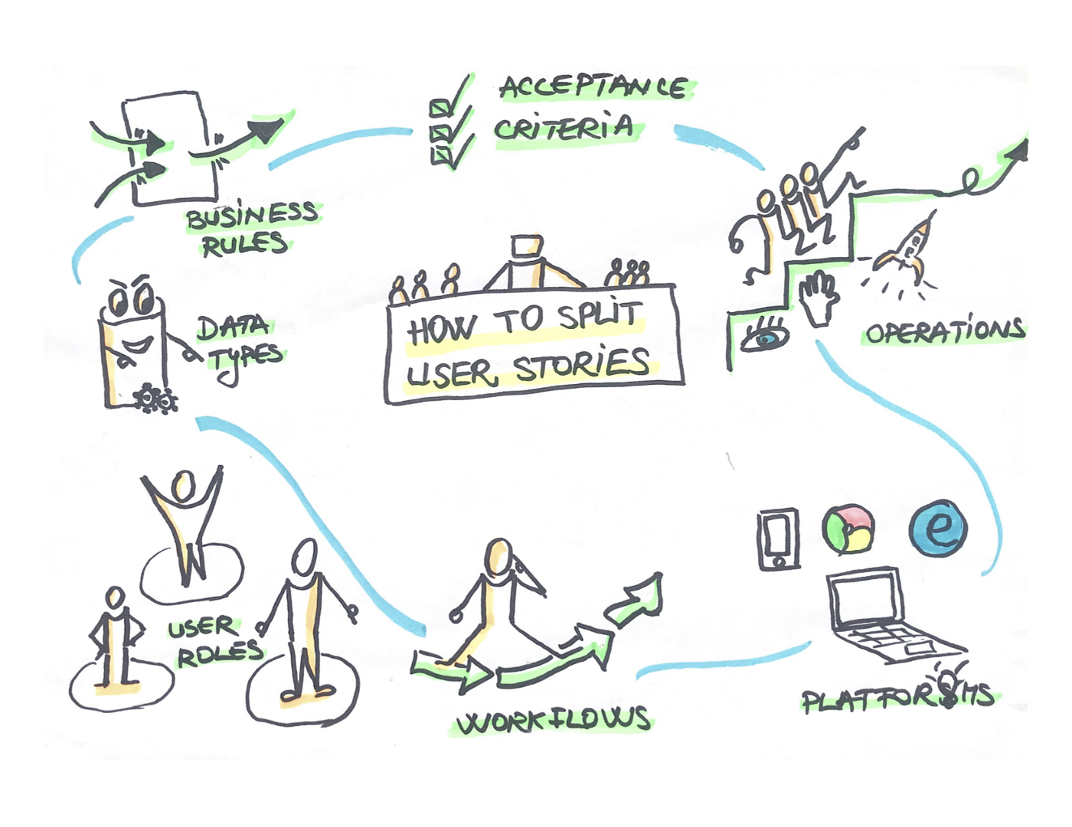
User Stories/Research
“The average number of social media accounts is 8.4 per person in 2020”
Patty ~ “I am a very social person, so I have all the popular social media apps to communicate with my friends and stay up to date on any latest news.”

Slide 6
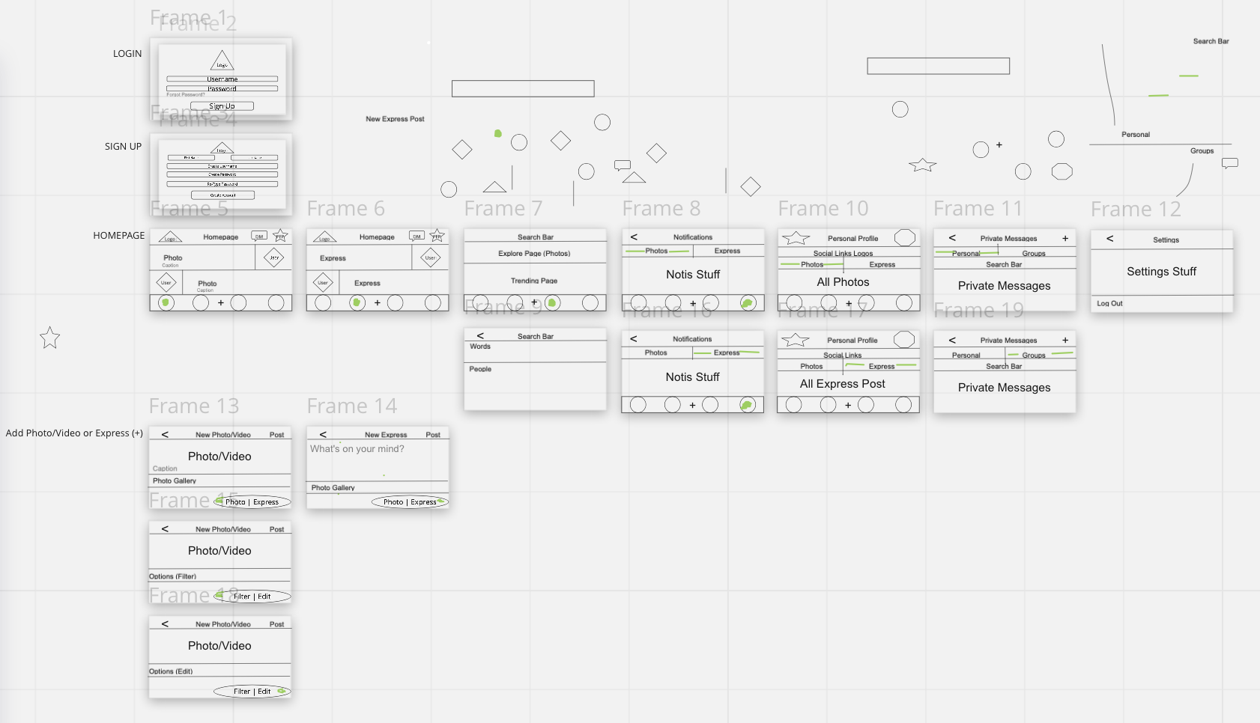
Lo-Fi Wireframes
https://miro.com/app/board/o9J_lnyFsB0=/?invite_link_id=391035630061

Slide 7
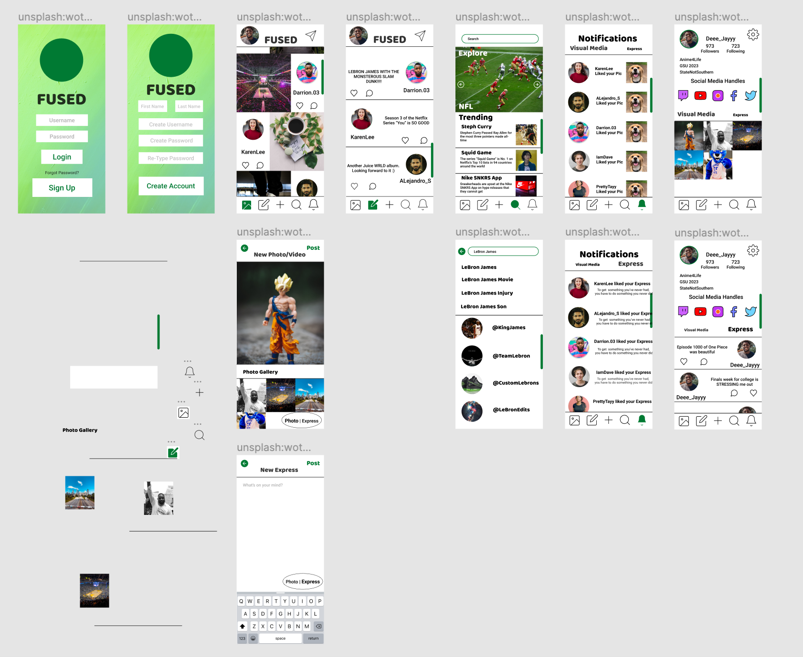
Hi-Fi Wireframes
https://www.figma.com/proto/JqGbKlpXgcskTAzDoNz5Ko/GSU-Ui-Ux-High-Fidelity?node-id=0%3A1

Slide 8
Key Takeaways
Very proud especially for my first Ui/Ux project
I felt that Ui/Ux is easy to learn but takes a ton of planning/research
Added features from other popular social media apps ex. Tiktok and Snapchat
I wish we learned more about user research
I want to implement Ui/Ux to the career I’m pursuing in (Frontend Developer)

